Slide 1
C++17 Basics
Milorad Papic / Robert Meier

Slide 2
C++17 New Features (link leads to examples)
Nested namespaces
Inline variables
Brace initialisation
Structure binding
If with variable
Lambda [*this]
Invoke

Slide 3
C++17 New Features (link leads to examples)
compile time if (if constexpr)
class template type deduction
emplace functions return reference to object
std::optional
std::variant
binary fold expressions

Slide 4
C++17 New Features (not presented here, links to cpp reference)
class template deduction guides
std::filesystem
std::string_view
new algorithms and parallel execution policy
e.g. parallel for_each execution
no gcc support at the moment

Slide 5
Video Resources
C++17 - The Best Features - Nicolai Josuttis [ACCU 2018]
CppCon 2017: Jason Turner “Practical C++17”
CppCon 2018: Mateusz Pusz “Effective replacement of dynamic polymorphism with std::variant”
CppCon 2017: Dietmar Kühl “C++17 Parallel Algorithms”

Slide 6
How to compile and run in repl.it with C++17
Click on the left side where your text is
Press F1
Type „open shell“
In new shell type „g++ -std=c++17 <cpp files> && ./a.out“

Slide 7
BACKUP

Slide 8
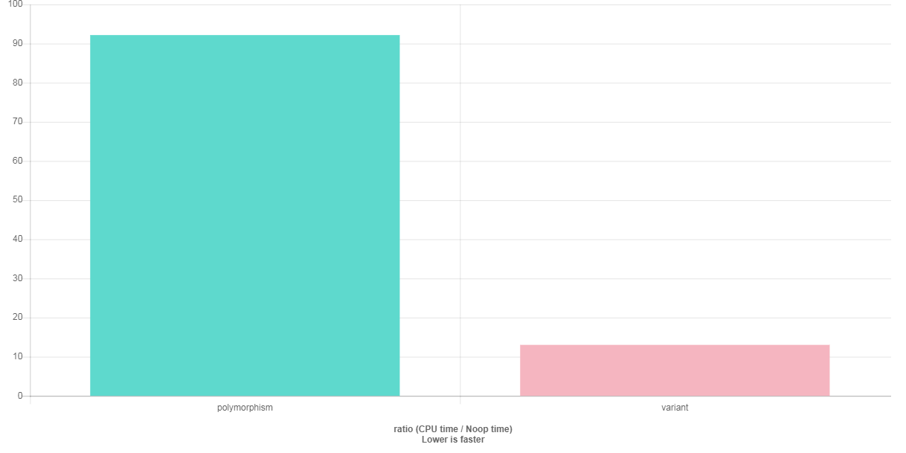
performance - std::variant vs. polymorphic loop calls
based on example for std::variant
http://quick-bench.com/q--hAnkm2CYn81qNFYJtXeFDg-Q

